Slide 1
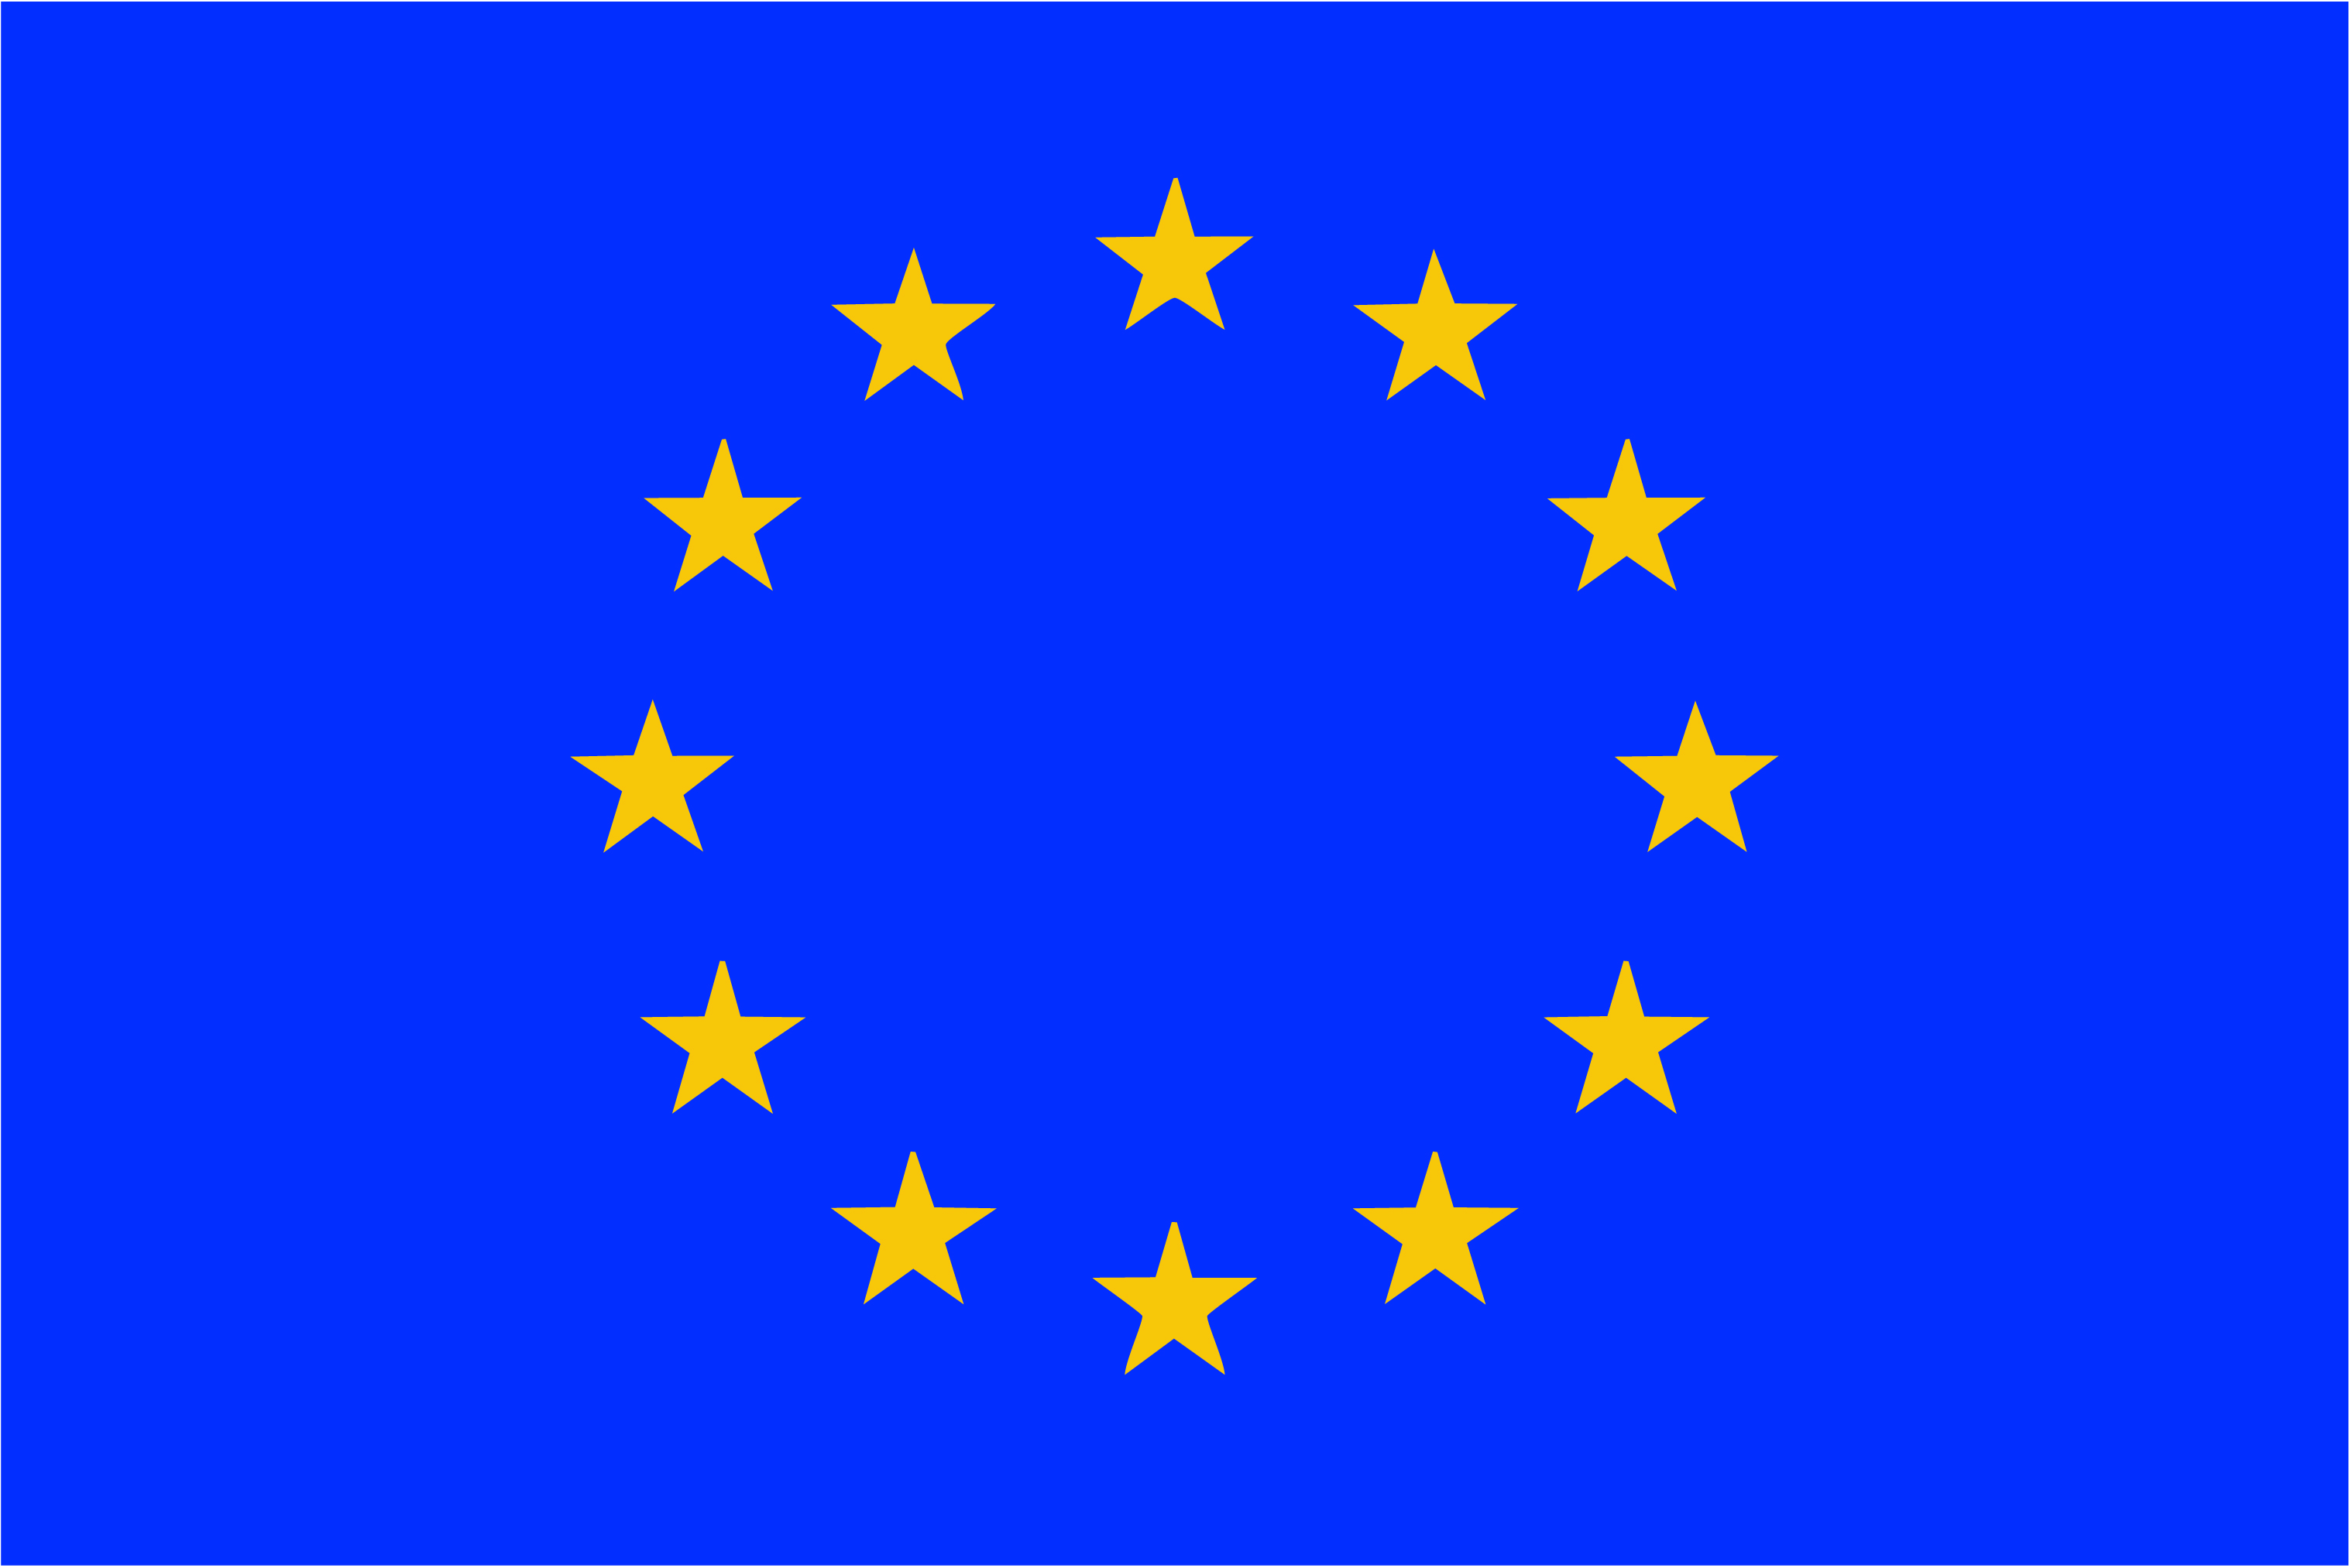

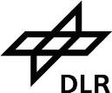











Consistent Data Records From Microwave Sounders
FIDUCEO has received funding from the European Union’s Horizon 2020 Programme for Research and Innovation, under Grant Agreement no. 638822
I. Hans, T. Lang, S. A. Buehler, M. J. Burgdorf, M. Prange

Slide 2
Consistent Data Records From Microwave Sounders
FIDUCEO has received funding from the European Union’s Horizon 2020 Programme for Research and Innovation, under Grant Agreement no. 638822
I. Hans, T. Lang, S. A. Buehler, M. J. Burgdorf, M. Prange

Slide 3


Slide 4

Microwave humidity sounding
Advanced microwave sounding unit - b
Special sensor Microwave - humidity
Fiduceo microwave easy fcdr

Slide 5
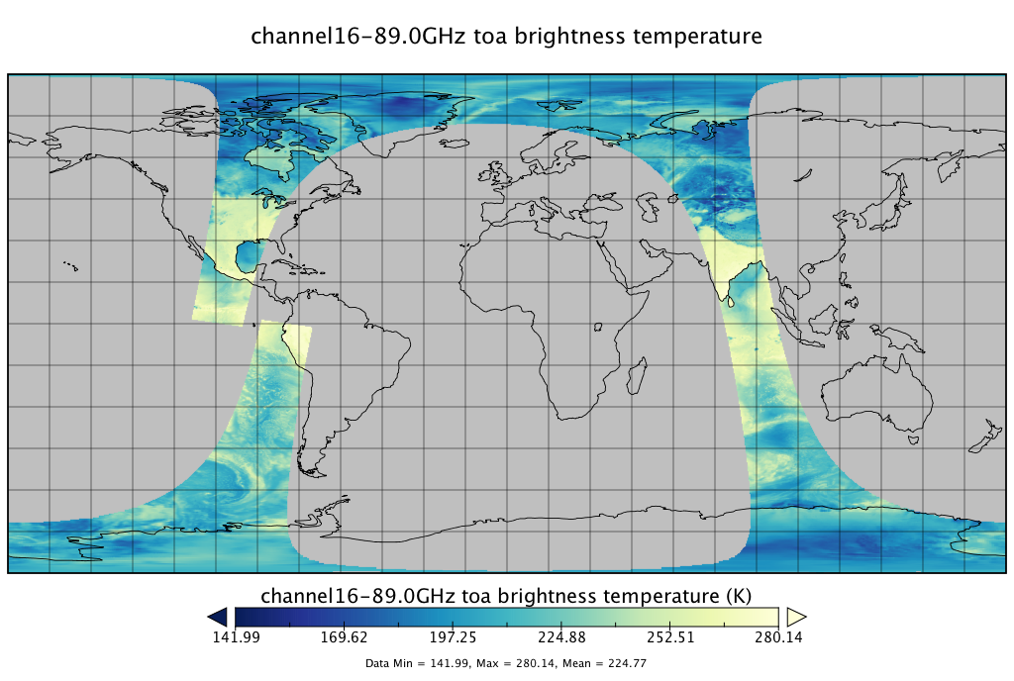
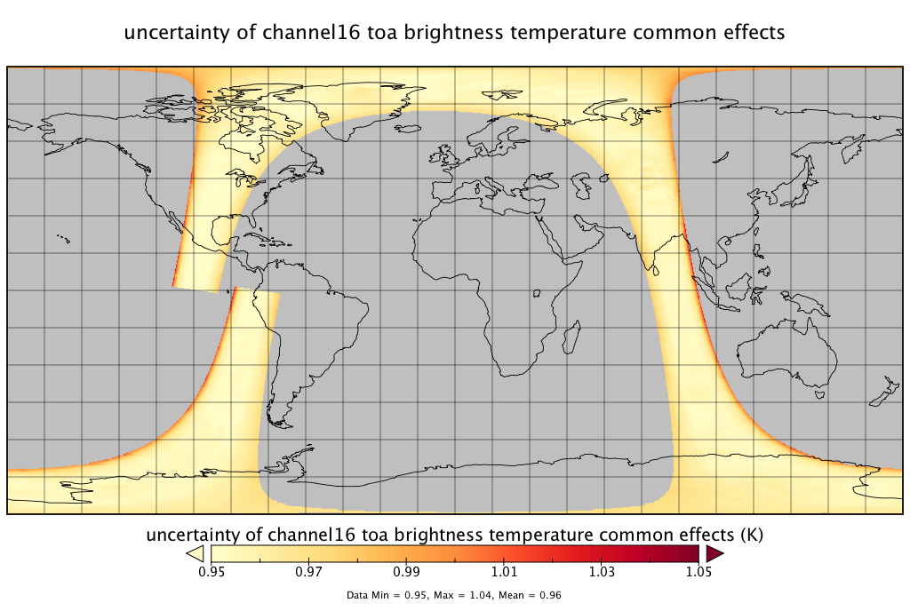
What is New?
Features of FIDUCEO FCDR & Example Contents
Data format: NetCDF
  Easy to use
  Attributes explaining the variables
Data arrangement: equator – to – equator
On pixel-level:
  Brightness temperatures for channels
  Uncertainties due to independent, structured, and common effects
  Quality information
Improved antenna pattern and radio frequency interference corr.
Information on transmitter status in bitmask for scan line quality (helpful for RFI related issues)
Per scan line: original scan line number and file (level 1b)

Slide 6
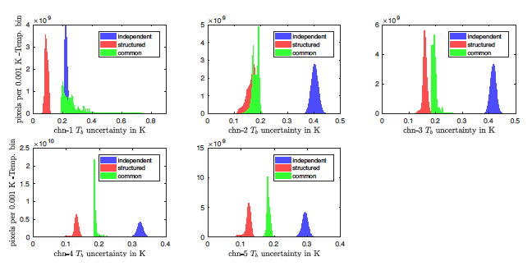
Uncertainties: Relative Importance
Histogram of the three classes of uncertainties:
September 2014
MHS on Metop-B
Similar pattern for the three sounding channels
Long tail for common effects in channel 1 due to antenna pattern correction
Except for channel 1, the independent uncertainties dominate the others

Slide 7
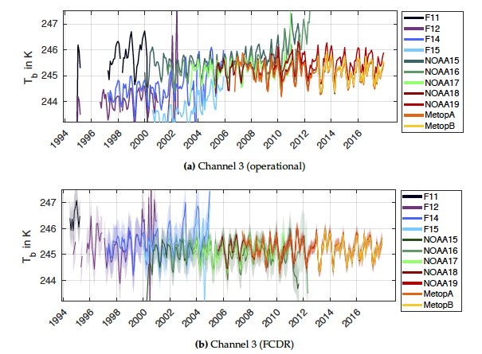
Comparison of T_{b} From AAPP/Fiduceo, Channel 3
The FCDR from FIDUCEO provides more consistent and stable time series
The shaded regions denote the uncertainty due to common effects for FIDUCEO
There is no uncertainty estimate on pixel level for the products of AAPP

Slide 8
upper tropospheric humidity cdr

Slide 9
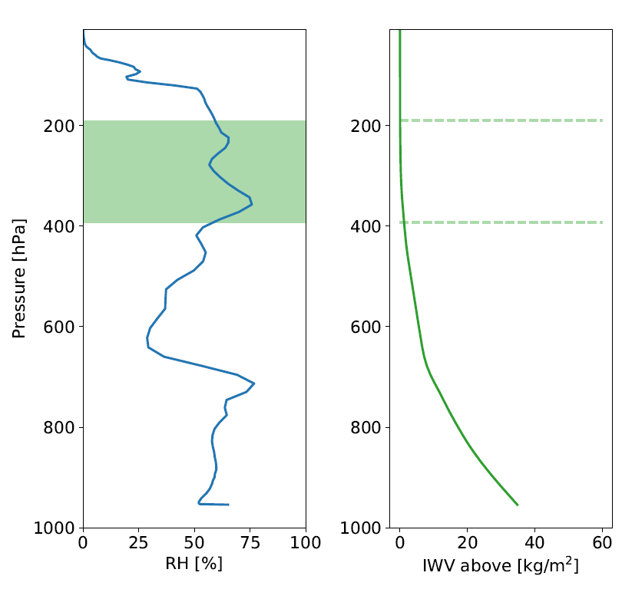
A New Definition of UTH and New CDR Content
CDR content:
  Monthly averages of UTH and BT in the tropics
  Regular lat/lon grid
  1°×1° resolution
  Separate data fields for ascending and descending overpasses
  Uncertainty information
Uncertainties for UTH and BT propagated from FCDRs
Correlations between individual pixels lead to correlations between the individual grid cell average
Idea: UTH = vertical average of RH in an IWV layer (defined by Wu et al., 1993)
Advantages: Same definition for IR and MW with same thresholds, value follows directly from model atm.

Slide 10
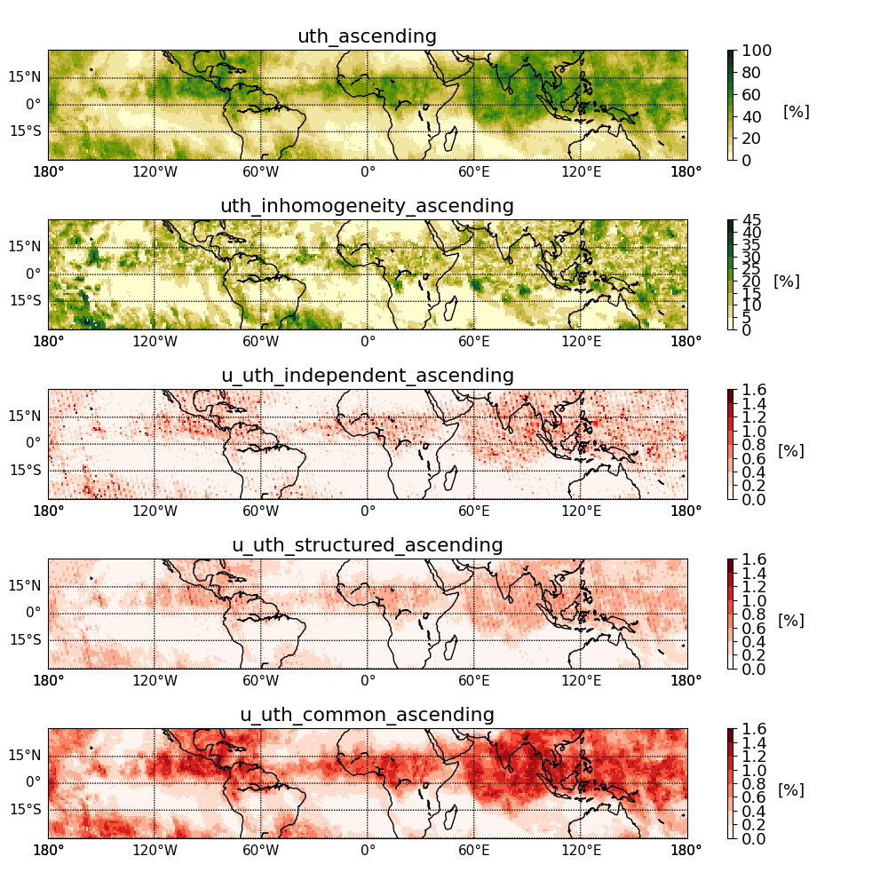
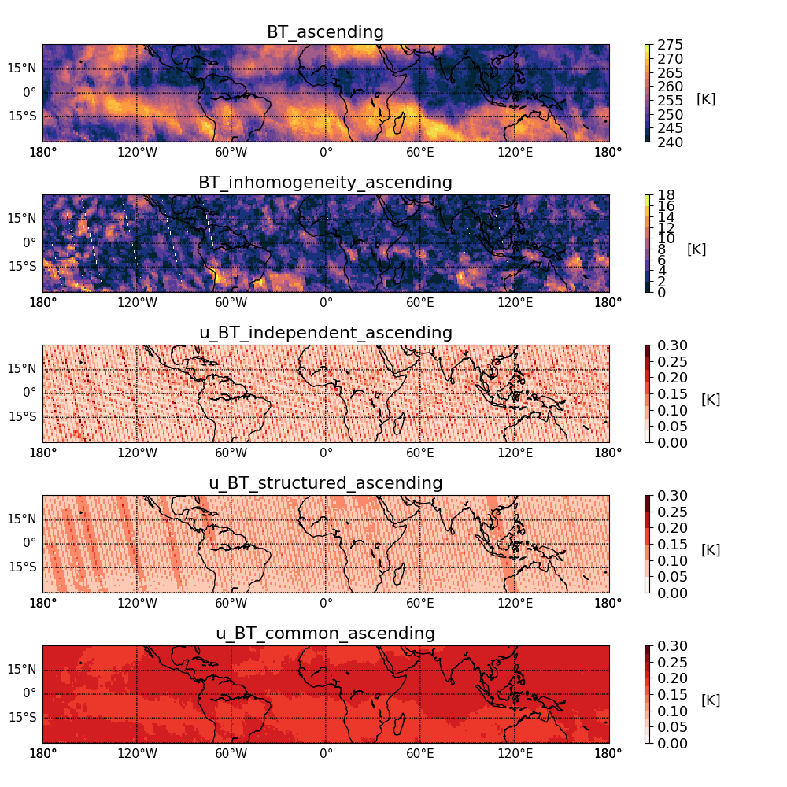
Example CDR Content
July 2012 from ascending passes of MHS on NOAA18
UTH + Uncertainties
BT + Uncertainties

Slide 11
Inter-calibration of microwave sounders

Slide 12
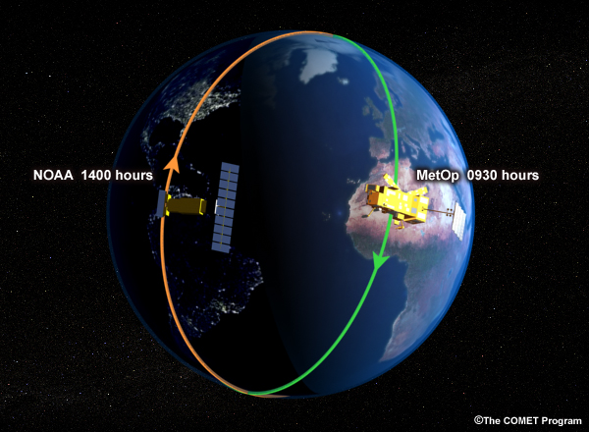

Opportunistic Constant Target Matchups - Methodology
Basic idea:
  Instead of temporal matching, SEVIRI radiance (6.2 μm) has to match.
Complements SAACs very well.
Mitigates effect of diurnal cycle on inter-calibration that is present with averaging methods.
4.5 h apart
SEVIRI
(geostationary)

Slide 13
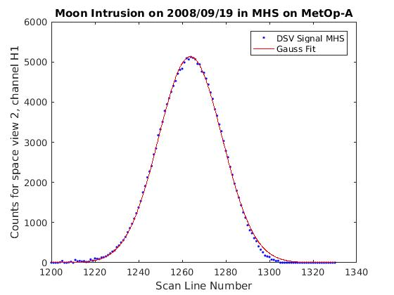
The Moon as Microwave Calibration Reference
Check Pointing, Beam Size, and Sounding Channel Uniformity in Flight
Check Photometric Stability With T_{B} = f(φ) and Hundreds of Moon Intrusions in DSV

Slide 14
Conclusions
FCDRs for all channels of MHS, AMSU-B, SSM/T-2
    Consistent calibration resulted in significant reduction of bias
Upper tropospheric humidity calculated from FCDRs
    Uncertainties propagated from FCDR to CDR
    Binning to Lat/Lon grid and monthly averages
Characterization of instrumental effects and noise => user-friendly set of T_{B} and UTH for the period 1994 – 2017
FIDUCEO has received funding from the European Union’s Horizon 2020 Programme for Research and Innovation, under Grant Agreement no. 638822

