Slide 1
Noise performance of microwave humidity sounders over their life time
Imke Hans
Universität Hamburg
Imke Hans¹, Martin Burgdorf¹, Viju O. John^{2,3}, Jonathan Mittaz^{4,5}, and Stefan A. Buehler¹
1 Meteorologisches Institut, Centrum für Erdsystem- und Nachhaltigkeitsforschung (CEN), Universität Hamburg
2 EUMETSAT, Darmstadt
3 Met Office Hadley Centre, Exeter, United Kingdom
4 Department of Meteorology, University of Reading, Reading, UK
5 National Physical Laboratory, Teddington, UK

Slide 2
Motivation
How does the noise of the MW instruments SSMT2, AMSUB and MHS
evolve over their life time?
New aspects in
Noise: Definition and calculation using Allan Deviation
MW instruments: individual instruments of SSMT2, AMSUB, MHS on all platforms
Evolution: assessment over whole life time
→ goals
  overview of usable data
  insight to known issue
  input for uncertainty budget of new FIDUCEO FCDR

Slide 3
Outline
Method: Noise definition and calculation
Main results
  Noise Evolution and usable data
  Insight to known issue: AMSU-B N16 bias vs other instruments
  Input for uncertainty budget in FCDR
Conclusions

Slide 4
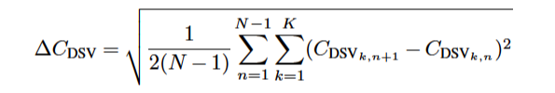
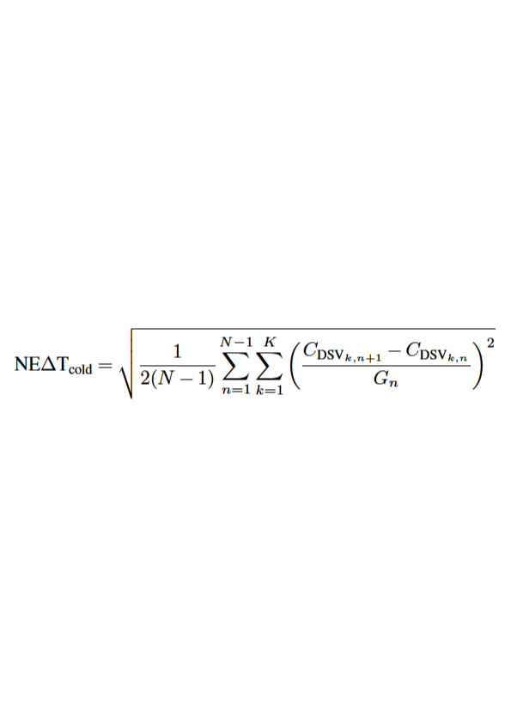
1. Method
Noise definition
Noise calculation
“count noise”: Fluctuations in instrumental counts:
  Deep space view (DSV)
  View of the internal warm calibration target (IWCT)
Noise Equivalent Differential Temperature (NEdT)
  From DSV counts: “cold NEdT”
  From IWCT counts: “warm NEdT”
  Rescaling to “scene NEdT”
Allan Deviation: inter-scanline-wise, on each calibration view
Advantage: not sensitive to orbital variations
Scaling of count noise to Temperature NEdT

Slide 5
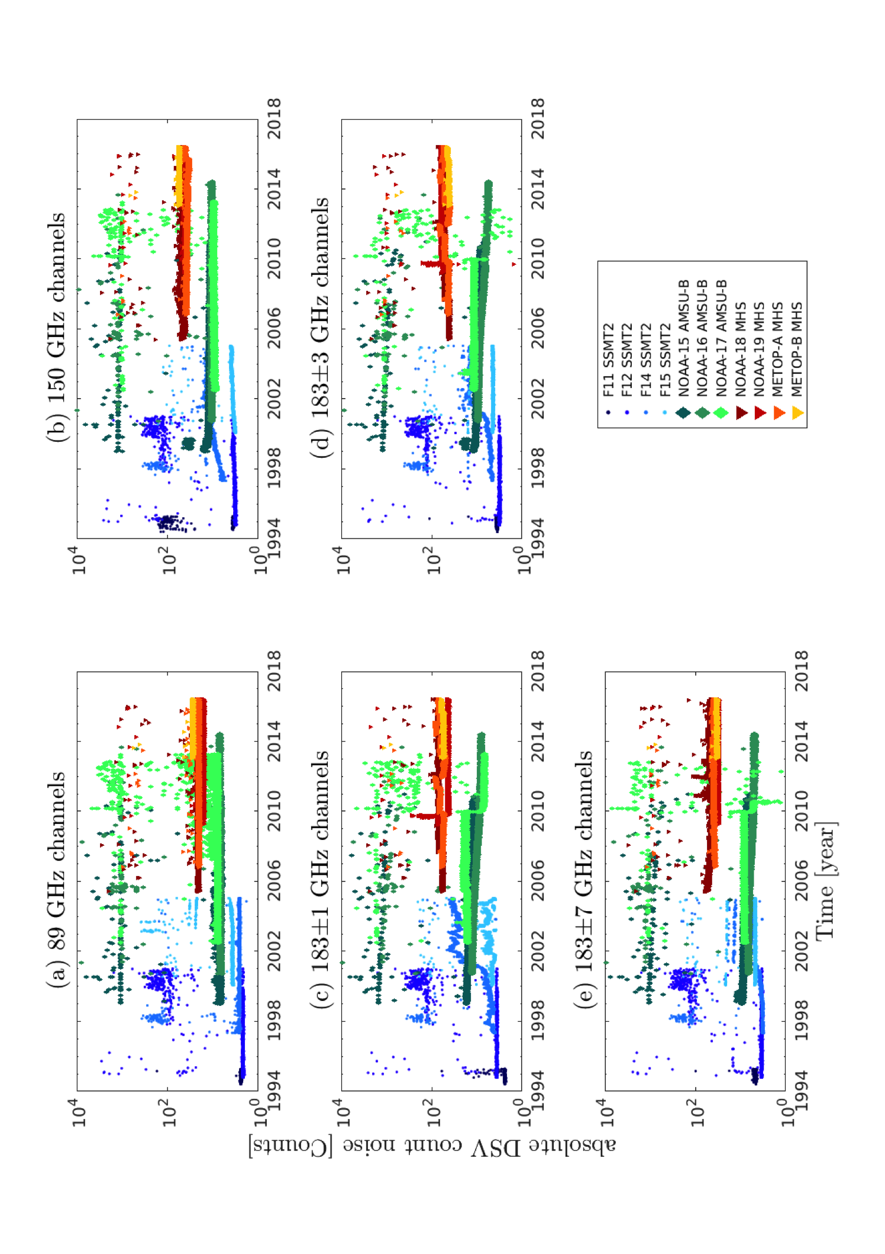
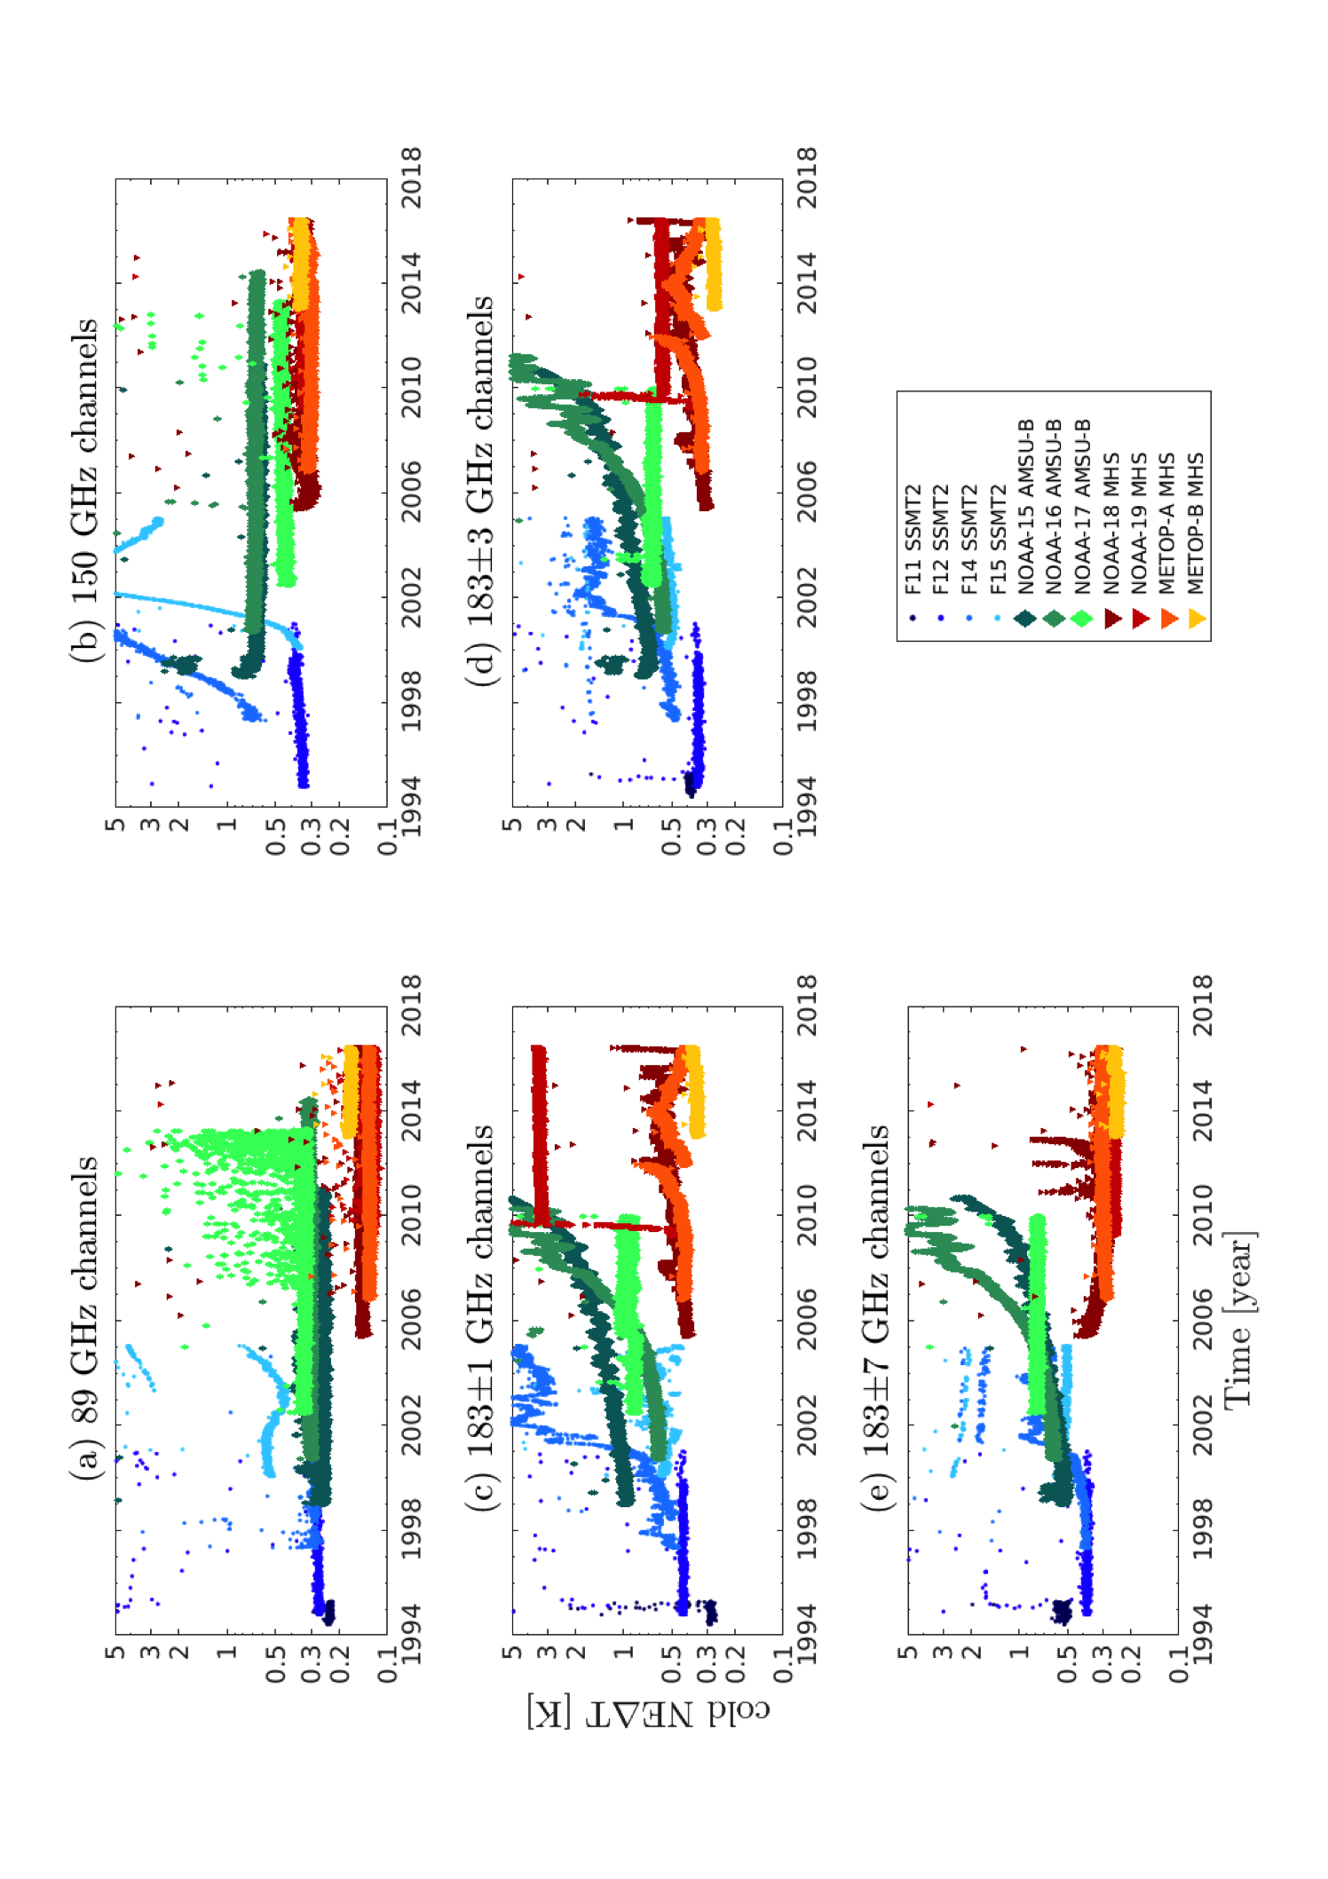
2.a. Noise evolution and usable data
DSV Count noise
Cold NEdT
Behaviour of Count noise and NEdT:
  Changes in count noise → changes in NEdT
  But: NEdT also reflects changes in gain
Evolution different for instruments and channels
  e.g. strong degradation of NOAA15, 16 in Ch3 NEdT
  on METOP-B: Very stable count noise and NEdT

Slide 6
2.a. Noise evolution and usable data
Usable data:
e.g. NEdT <1K
For NEdT <1K: time series for all channels without gaps may be constructed
Periods of cold NEdT < 1 K
→ “quick look” overview of noise and NEdT for all instruments and channels

Slide 7
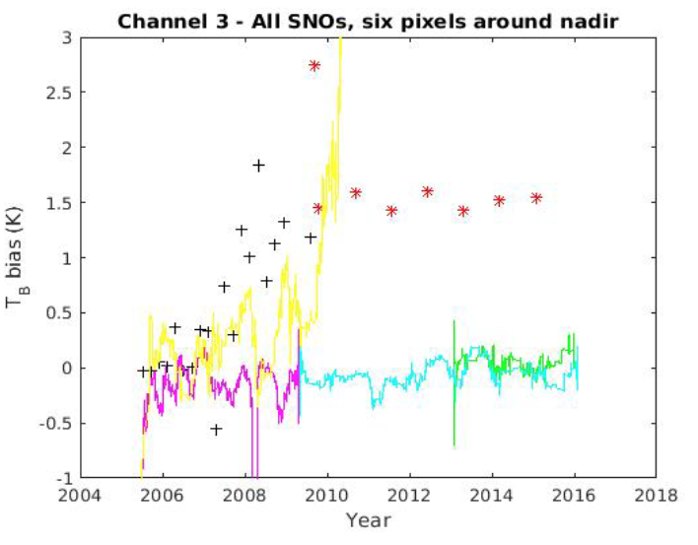
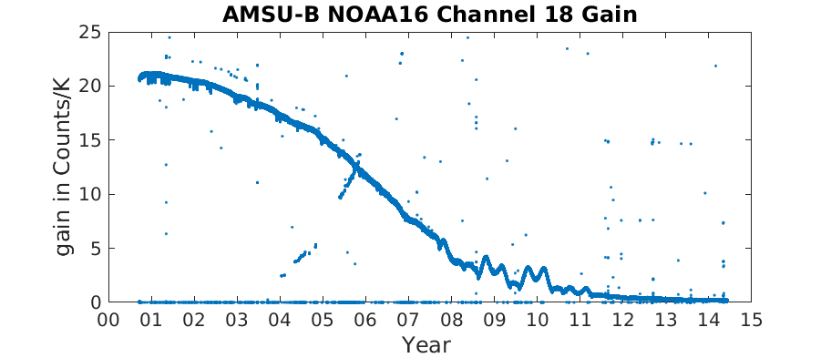
2.b. Insight to N16 bias
Bias N16 vs MHS N18 (yellow) increases dramatically…
…so does NEdT (green)
…because of the decreasing gain
RFI has more impact → likely to cause the bias

Slide 8
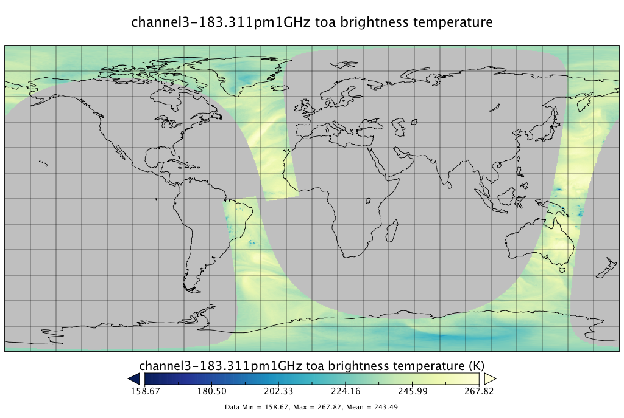
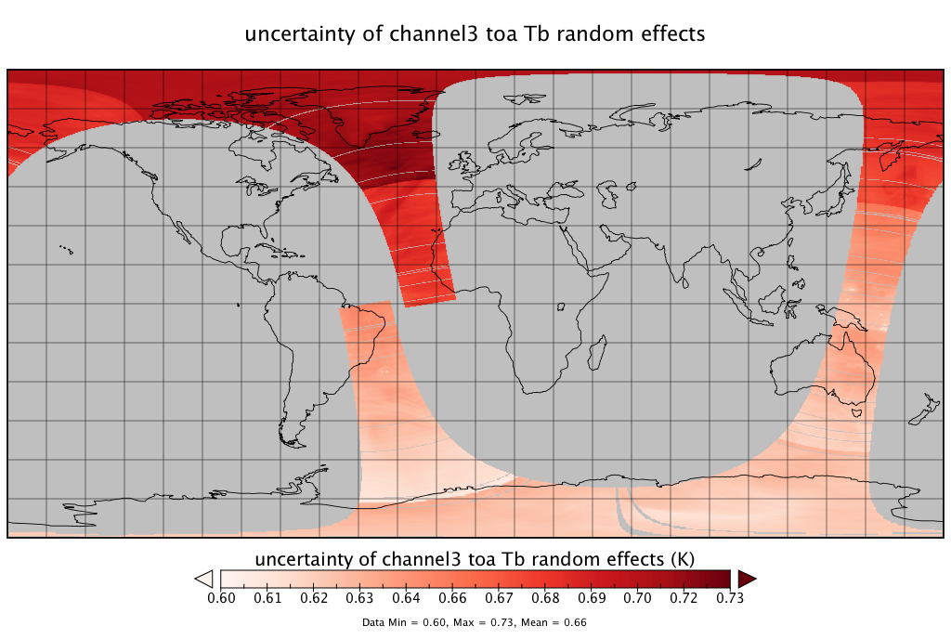
2.c. Input for uncertainty budget in FIDUCEO FCDR
Count noise estimation (Allan Dev.) applied in FCDR processing
DSV, IWCT, scene count noise estimated on-the-fly
Propagated to brightness temperature Tb
→ “uncertainty in Tb due to noise on scene counts” on pixel level

Slide 9
3. Conclusions
We have used: Allan Deviation (not sensitive to orbital variations) for estimating count noise and NEdT
We provide: Overview of count noise and NEdT evolution over life time of all individual SSMT2, AMSUB, MHS instruments
We suggest: RFI as possible explanation for AMSUB N16 bias
We provide: input for uncertainty budget of FIDUCEO MW FCDR which we work on

Slide 10
Thank you!

Slide 11
Back up slides

Slide 12
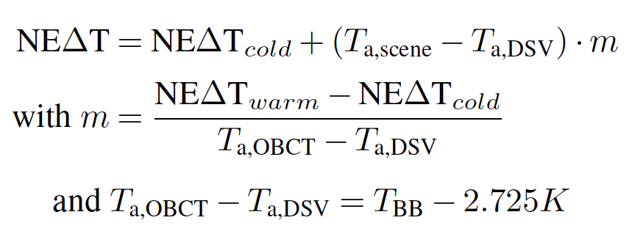
Scene NEdT
Rescaling for scene NEdT

Slide 13
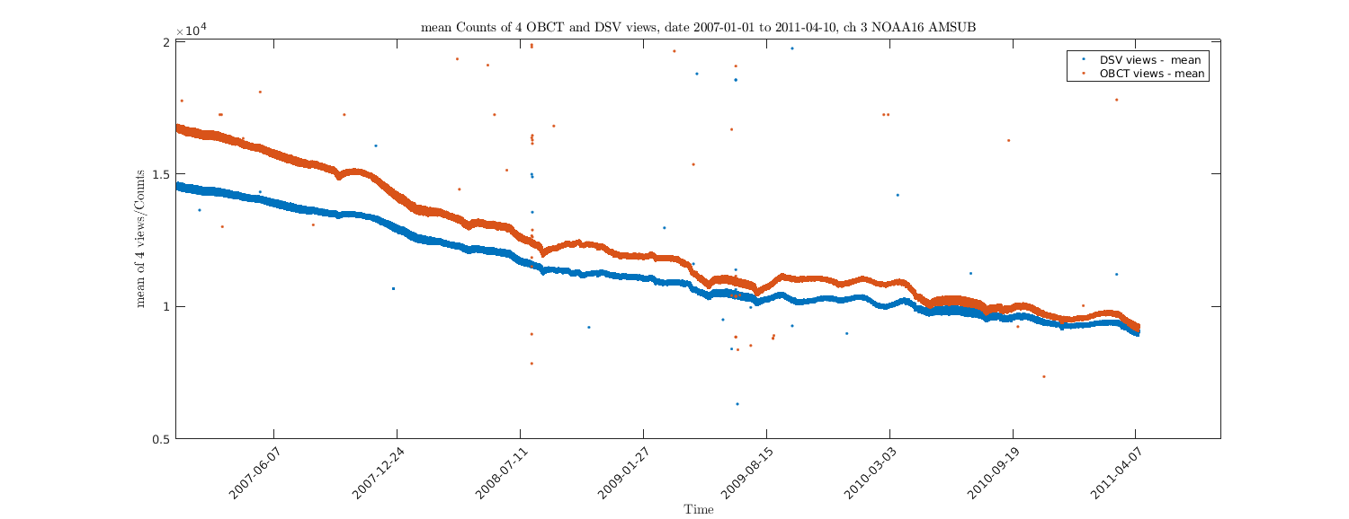
Gain decrease - evolution of counts Channel 3 AMSUB NOAA16

Slide 14
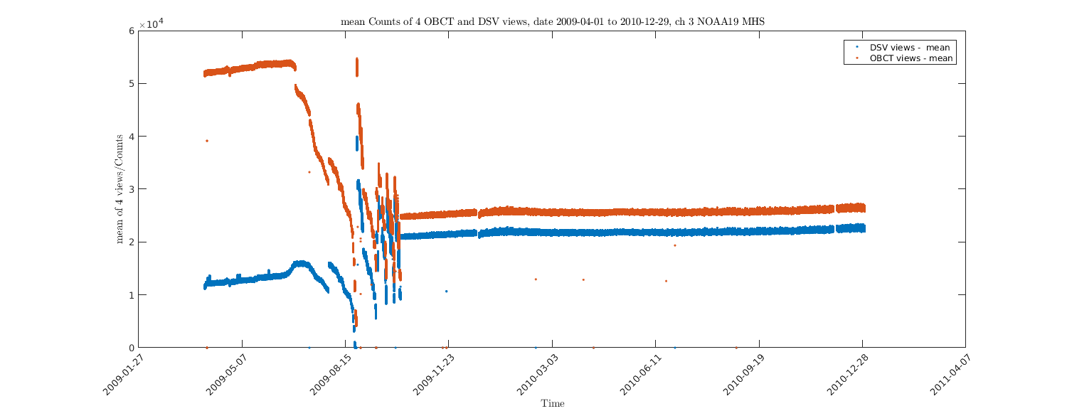
Gain decrease - evolution of counts Channel 3 MHS NOAA19

Slide 15
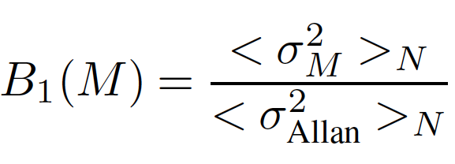
DSV count noise spectrum
Noise spectrum calculated with bias function
Ch2 has pink noise component
Ch3 has stronger pink noise component in 2006 than in 2003

Slide 16
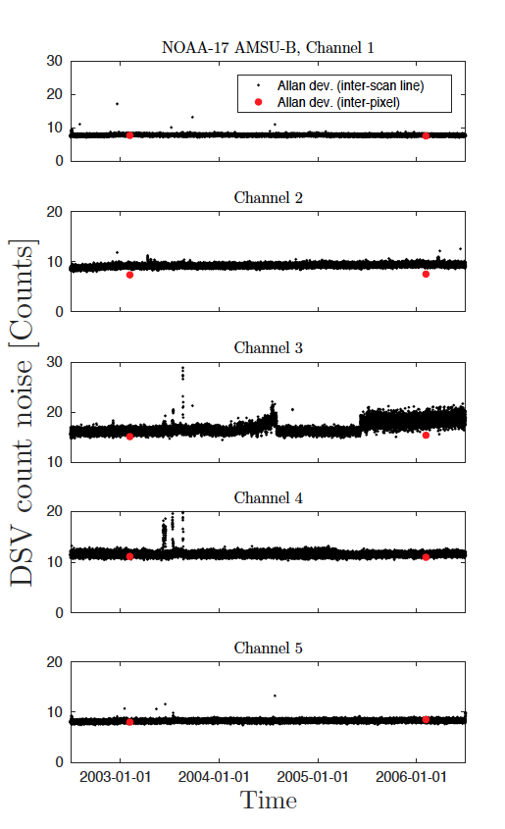
DSV count noise
Ch2: inter-pixel-method too low
Ch3: in 2006, when pink noise stronger, inter-pixel-method too low

